Slide 1
Improving Cybersecurity Culture in the Workplace: A Study of Training Practices and Perceptions
Group Name: We've Been Trying To Reach You About Your Car's Extended Warranty
Group participants names: James Henderson; Patricia Montoya; Maxwell Stolarenko

Slide 2
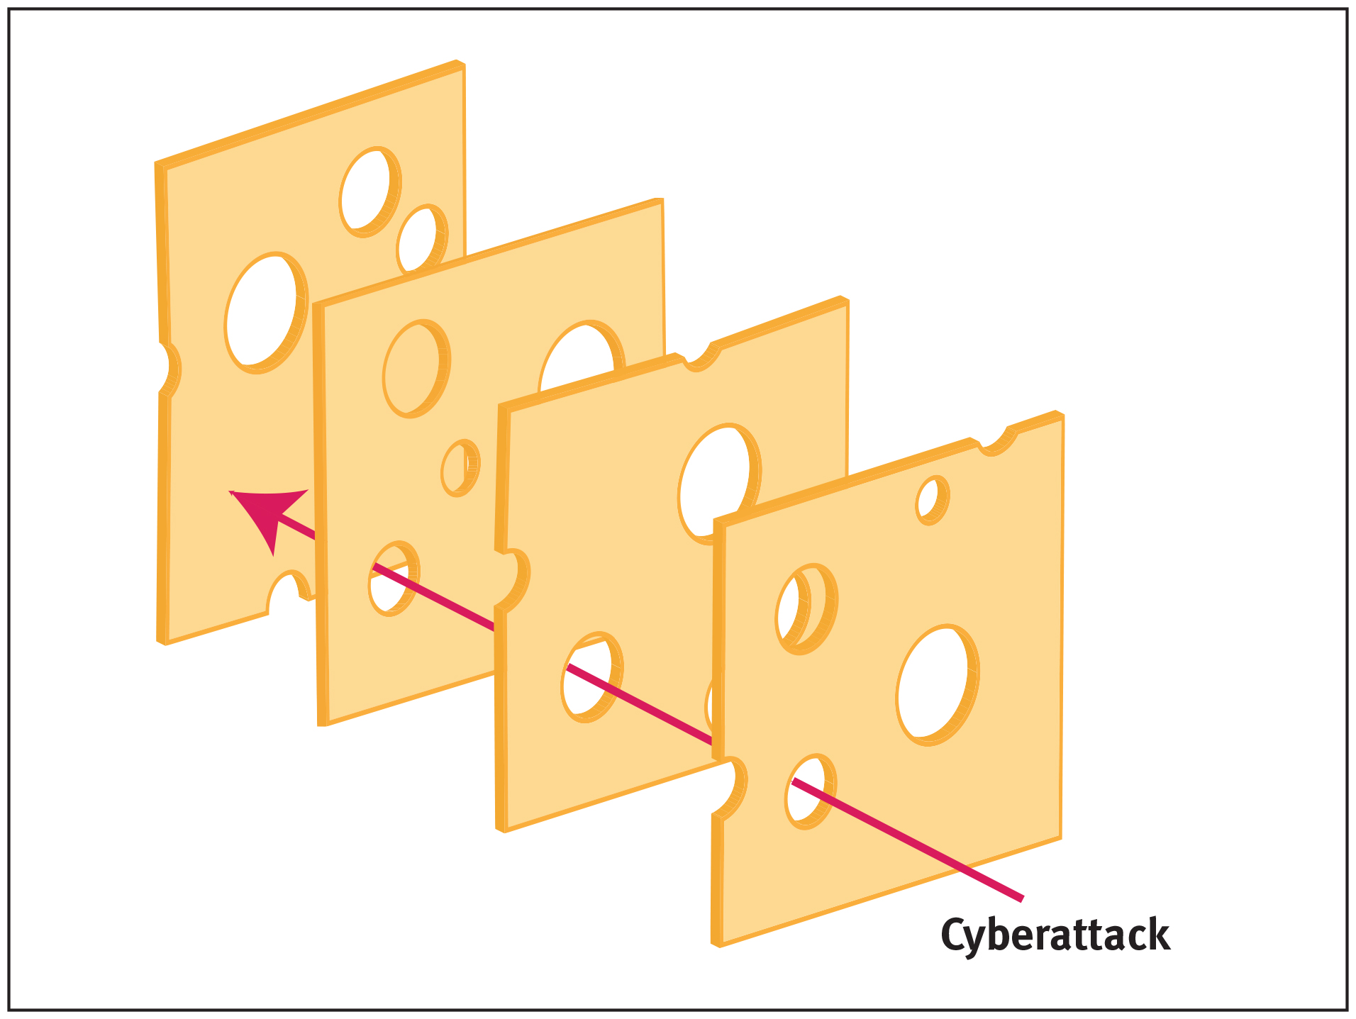
Introduction to the study
In 2020, the FBI's Internet Crime Complaint Center received over 240,000 complaints related to phishing attacks with an estimated 4.2 billion dollars lost to cybercrimes. Phishing and Fraud Report discovered a 220% increase in phishing attacks in response to the pandemic increasing cybercriminal opportunities.
There is a need for training programs that are not only effective in preventing phishing attacks but also easy for users to engage with and understand.
Our research proposal aims to investigate the relationship between perceived ease of use and perceived usefulness regarding a phishing prevention training programs

Slide 3
Research Questions and Objectives
How do employees perceive the usefulness of cybersecurity training in their workplace, and what factors influence their perceptions?
What specific aspects of cybersecurity training do employees find most useful or valuable, and why?
Our research aims to:
To investigate the role of perceived ease of use and perceived usefulness in cybersecurity training programs
To identify which aspects of phishing prevention training influence an employees’ attitudes and behaviors
To provide recommendations for improving the design and delivery of training methods to enhance effectiveness

Slide 4
Literature Review
The Importance of Training the Human
Phishing preventive strategies include technical tools and non-technical skills relevant to human behavior. Technical tools do not have a perfect success rate, facilitating the need to reinforce the human as well with training (Jampen et al., 2020).
Perceived Usefulness of Phishing Training
Participants that placed little trust in the usefulness of their phishing detection tools and instead relied on intuition noticeably fell for significantly more phishing attempts (Abbasi et al., 2016).
Perceived Ease of Use of Phishing Training
Participants may develop improper cybersecurity habits, actively seek workarounds, or be prone to making more frequent errors from cyber fatigue in both directions of how they perceive difficulty and frequency (Reeves et al., 2021)

Slide 5
Literature Gaps
Research on the perceived usefulness of phishing prevention only covered using technical tools and not training the human
The perceived ease of use literature covered did not focus specifically on phishing training nor did it employ self-report measures for a qualitative understanding

Slide 6
Research Methodology
This case study will identify the quality of the content presented in training and the perceived quality of the content according to the trainees.
The research will focus on industry professionals who are familiar with cybersecurity trainings but will not have above-average awareness of cybersecurity
Through snowball sampling, chosen participants will fill out the Qualtrics survey composed of open-ended questions and 5-point Likert scale questions.
Following the survey, participants will receive a short phishing training followed by open-ended questions to further explore their perceptions on these types of trainings.

Slide 7



UCF Cybersecurity Phishing Training

Slide 8
Data Collection and Expectations
The pretest will gather information on participants' expertise on cybersecurity, previous training, frequency of engagement with networked computers, experience with phishing, and perception of cybersecurity training.
An interview will be conducted with a mix of open-ended and structured questions to explore participants' insights, their perceived level of understanding of the training content, and the extent to which the training has influenced their behavior and decision-making.
After engaging with the learning material, participants will be given a short quiz to test their level of understanding and the effectiveness of the training. The data collected from the quiz will be used to determine areas that need improvement in the training.

Slide 9
Conclusion
Problem Statement: Organizations lack an understanding of which factors influence an employee’s perceptions of the usefulness and value of cybersecurity training. Identifying these factors can improve the effectiveness of training programs and enhance overall security.
Research Question: What are the factors that influence employees' perceptions of the usefulness and value of different aspects of cybersecurity training in the workplace?

